Slide 1
HORIZON WEST INFRASTRUCTURE FUND INC.
INFRASTRUCTURE GROWTH FOR SUSTAINABLE FUTURE GENERATIONS
FUND PRESENTATION
Applicant Presentation

Slide 2
HORIZON WEST INFRASTRUCTURE FUND (HWIF)
HWIF is an innovative financing vehicle that facilitates access to capital. Our goal is to increase the opportunity for municipalities successfully building back better. Sustainable, inclusive, alignment between private and public investment is our mission. Building sustainable communities is the benefit.
Horizon West provides a funding instrument to facilitate direct investment into infrastructure projects within Western Canada through one of our various funds (The Fund)”.

Slide 3
Team Attributes
Our management team is a diverse and experienced group. Several members of the team have strong financial credentials and many have come from a entrepreneurial background.
Our board consists of entrepreneurs, accountants, lawyers, engineers and finance professionals with over 200 years in aggregate management experience.
All board members have held senior management positions.
Some are “Roads Scholars”, having worked in the construction & development industries, obtaining a clear understanding behind the challenges in completing infrastructure projects.
(See website at www.hwif.ca-management+Board)
3

Slide 4
FUND MODEL
The fund provides access to the capital required for infrastructure projects for communities throughout Western Canada.
Upon approval HWIF will lend to municipalities for 5 year terms with a 25 year amortization. Interest rates are competitive and include ESG reporting costs.
HWIF will fund projects once the applicant has passed HWIF ESG and Financial risk analysis receiving the requisite regulatory approvals.

Slide 5
WHY HWIF IS THE RIGHT CHOICE?
Our team members, board, and management, all have dedicated their professional lives to contributing to the prosperity of the West and as such have “boots on the ground” experience in planning, constructing and financing projects.
HWIF is a highly dedicated infrastructure lender able to deliver competitive rates while ensuring projects meet both current and future ESG requirements. HWIF works with communities to ensure that they can “afford projects” and helps to develop business plans if necessary through its in-house consulting firm, Q4 Consulting Corp.
HWIF is the only infrastructure fund in Canada with third party ESG risk analysis built into it’s model. We ensure that your projects have passed the scrutiny of the current legislation changes involving carbon footprint and social impact. This alone will be a “feather in the cap” of the borrower.

Slide 6
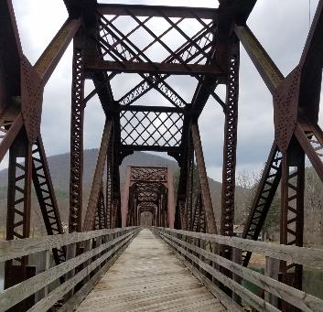
HWIF FILLS THE FUNDING GAP
By dealing directly with municipalities to provide them with access to Capital so they can finance their share required under ICIP and in so doing fills the Funding Gap.
By complimenting federal and provincial government infrastructure grants.
By partnering with other financial institutions to co-fund sustainable infrastructure projects.
By providing stand alone funding for sustainable infrastructure projects to municipal communities in Western Canada ranging from $5M+ per approved project on a 75% loan to value.
By delivering third party ESG verification through our strategic partner ESSAFIN LOGIC, HWIF is committed to international environmental, social and corporate governance standards.

Slide 7
OUR LENDING STRATEGY
HWIF lends against the strength of the Borrower’s assets, and requires regulatory approval for the Borrowers, or HWIF will not lend.
HWIF will co-lend with partners either through its Municipal Fund, Alt Energy Fund or Indigenous Fund in order to provide complimentary funding to existing federal and provincial grants or loans thereby filling in the funding gaps.
HWIF lends monies by way of debt instruments, which are secured against a diversified portfolio of Western Canadian infrastructure projects.

Slide 8
OUR LENDING PROCESS
Structured, efficient, oriented, and result driven.
Borrower applies to the Fund for loan. Once a preliminary application fee is taken, loan information will be processed.
Letter of Commitment is executed by Borrowers and instructions forwarded to lawyers to be signed, closed and registered, and coordinate if necessary distribution of funds with syndicate partners.
HWIF determines whether Application meets its ESG criteria. If yes, it proceeds with the Application.
Credit Committee determines whether loan will be made based on three criteria: 1) ESG assessment 2) Ability to repay 3) Security. Upon committee approval, letter of commitment issued to Borrowers.
HWIF reviews application.
HWIF issues term sheets for review by the Borrowers. If necessary the municipality obtains regulatory approvals and Borrower pays preliminary finance fee.
HWIF risk committee reviews application, and if acceptable, forwards the term sheet with its recommendations to the credit committee for final approval.

Slide 9
LENDING FUNDS
HWIF will lend monies on infrastructure projects on a stand alone bases and will also co-fund with provincial and federal governments’ projects.
HWIF will lend up to 75% of financing for government approved infrastructure Projects to municipalities, counties and First Nations, specifically water treatment plants, wastewater treatment plants, bridge construction/remediation and educational facilities in Western Canada.
We encourage regional cooperation to increase the capacity for long-term sustainable infrastructure solutions.
Application is open to Local Governments, First Nations, Communities, Service Providers, Developers, Private Communications and Private Utility Developers.
HWIF requires participation either contractually or financially from a municipal, indigenous, federal agency or federal or provincial crown corporation so as to lend funds to prospective borrowers.

Slide 10
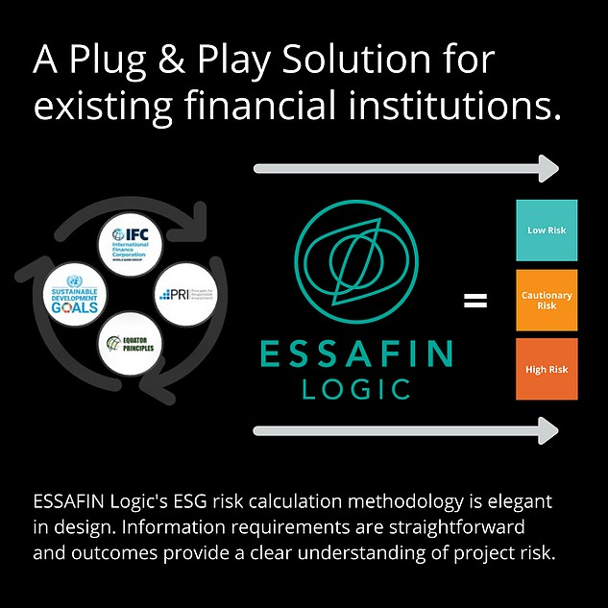
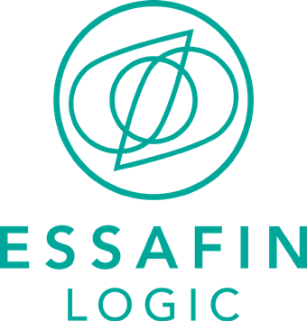
ESSAFIN Logic -Third Party ESG Risk Analysis Partner
Third party independent assessment of ESG (provided by ESSAFIN Logic SAAS)
The objective of Essafin Logic is to clearly identify ESG risks of projects/processes for the ultimate purpose of strengthening the long-term sustainability of the investment.
Essafin is a Canadian firm that has developed a proprietary SAAS of which objectively integrates globally recognized standards: Equator Principles, IFC, UN 17 SDG’s and Circular Economy.

Slide 11
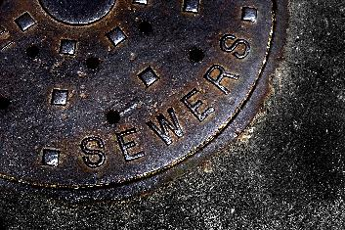
THE BENEFITS TO COMMUNITIES OF HWIF
Secure and stable long-term funding.
Targeting to complete project financing within 120 days.
Implements the highest standard of Environmental, Social and Governance (ESG) criteria directly into its lending criteria to ensure all projects either meet or exceed provincial and national standards, without impeding project development.
By meeting ESG approvals from HWIF, and, with accompanying regulatory approval, communities can be assured that they are putting into place sustainable and affordable infrastructure in order to satisfy their immediate and long-term needs.

Slide 12
THANK YOU
(306) 530-2738
www.hwif.ca
info@hwif.ca

Slide 13
LEGAL DISCLAIMER
©2019 Horizon West Infrastructure Fund Inc. All rights reserved. Unless otherwise noted, “HWIF” and all other marks used in this presentation are trademarks of Horizon West Infrastructure Fund Inc. (the “Company”). Any reproduction or dissemination of any feature of this presentation, in whole or in part, or any use of this presentation for any unlawful purposes, is strictly prohibited.
This presentation contains certain statements that may be deemed "forward-looking statements "including future-oriented financial information and financial outlooks (“FOFI”) within the meaning of applicable securities laws. Forward-looking statements are statements that relate to future, not past, events. In this context, forward-looking statements often address expected future business and financial performance, and often contain words such as "anticipate", "believe", "plan", "estimate", "expect", and "intend", statements that an action or event "may", "might", "could", "should", or "will" be taken or occur, or other similar expressions. All statements, other than statements of historical fact, included herein are forward-looking statements and are based upon assumptions regarding expected growth, results of operations, performance, industry trends and expansion opportunities. By their nature, forward-looking statements involve known and unknown risks, uncertainties and other factors which may cause the actual results, performance or achievements, or other future events, to be materially different from any future results, performance or achievements expressed or implied by such forward-looking statements. Such factors include, among others, the risks identified in the management discussion and analysis section of the Company's interim and most recent annual financial statement or other reports and filings with the applicable Canadian securities regulators. The purpose of the FOFI is to provide prospective investors with information pertaining to the Company’s longer term objectives. Readers should be cautioned that information may not be appropriate for other purposes. Forward-looking statements are made based on management's beliefs, estimates and opinions on the date that statements are made and the respective companies undertakes no obligation to update forward-looking statements if these beliefs, estimates and opinions or other circumstances should change, except as required by applicable securities laws. Investors are cautioned against attributing undue certainty to forward-looking statements.
The information provided in this presentation is provided solely for general knowledge purposes. This presentation is not intended to be a comprehensive review of all matters and developments concerning the Company and the Company assumes no responsibility for its completeness, accuracy and currency. Although information used in this presentation is believed to be accurate as at the date hereof, it may not be accurate when read. Neither the Company nor the Agent undertakes to update any of the information provided in this presentation.
THIS PRESENTATION IS PROVIDED “AS IS” WITHOUT ANY EXPRESS OR IMPLIED WARRANTY OF ANY KIND, INCLUDING WARRANTIES OF MERCHANTABILITY, NON INFRINGEMENT OF INTELLECTUAL PROPERTY, OR FITNESS FOR ANY PARTICULAR PURPOSE. IN NO EVENT SHALL THE COMPANY, THE AGENT, OR THEIR RESPECTIVE DIRECTORS, OFFICERS OR EMPLOYEES BE LIABLE FOR ANY DAMAGES WHATSOEVER (INCLUDING, WITHOUT LIMITATION, DAMAGES DUE TO LOSS OF PROFITS OR BUSINESS INTERRUPTION) DUE TO THE READER’S USE OF THIS PRESENTATION.
THIS PRESENTATION IS PROVIDED “AS IS” WITHOUT ANY EXPRESS OR IMPLIED WARRANTY OF ANY KIND, INCLUDING WARRANTIES OF MERCHANTABILITY, NONINFRINGEMENT OF INTELLECTUAL PROPERTY, OR FITNESS FOR ANY PARTICULAR PURPOSE. IN NO EVENT SHALL THE COMPANY, THE AGENT, OR THEIR RESPECTIVE DIRECTORS, OFFICERS OR EMPLOYEES BE LIABLE FOR ANY DAMAGES WHATSOEVER (INCLUDING, WITHOUT LIMITATION, DAMAGES DUE TO LOSS OF PROFITS OR BUSINESS INTERRUPTION) DUE TO THE READER’S USE OF THIS PRESENTATION.
This presentation is not to be construed as an offer to sell, or a solicitation of an offer to buy securities of the Company. An offer to sell, or a solicitation of an offer to buy securities of the Company can only be made by a broker-dealer registered in all jurisdictions in which such an offer is being made and only if such offer is otherwise made in accordance with all applicable securities laws, regulations, and rules of any kind whatsoever. The information in this presentation is not intended in any way to qualify, modify or supplement any prospectus or other information disclosed under the corporate and securities legislation of any jurisdiction applicable to the Company. No securities commission has in any way passed on any of the information contained in this presentation.
THE FOREGOING LIMITATIONS AND DISCLAIMERS APPLY REGARDLESS OF THE CAUSES OR CIRCUMSTANCES GIVING RISE TO THE LOSS, DAMAGE, CLAIM OR LIABILITY, EVEN IF SUCH LOSS, DAMAGE, CLAIM OR LIABILITY IS BASED UPON BREACH OF CONTRACT (INCLUDING, WITHOUT LIMITATION, A CLAIM OF FUNDAMENTAL BREACH OR A BREACH OF A FUNDAMENTAL TERM), TORT (INCLUDING, WITHOUT LIMITATION, NEGLIGENCE) OR STRICT LIABILITY.
This Presentation may not be reproduced, further distributed or published in whole or in part by any other person. Neither this Presentation nor any copy of it may be taken or transmitted into or distributed in any other jurisdiction which prohibits the same except in compliance with applicable laws. Any failure to comply with this restriction may constitute a violation of applicable securities law. Recipients are required to inform themselves of, and comply with, all such restrictions or prohibitions and neither the Company nor the Agent accepts any liability to any person in relation thereto.
The contents of this presentation are not to be construed as legal, financial or tax advice. Each prospective investor should contact his, her or its own legal adviser, independent financial adviser or tax adviser for legal, financial or tax advice. The Agent does not undertake to review the financial condition, forecasts, business or affairs of the Company at any time, nor to advise any investor or potential investor of any information in its possession or coming to its attention.

